Slide 1



Data Horizon Analytics Delhaize Team 2
Notes:
Photo by Markus Spiske on Unsplash Photo by Adi Goldstein on Unsplash

Slide 2




TEAM INTRODUCTION
Eleftherios Kokkinis, CEO, CTO
Master of Statistics & Data Science
Country of Origin: Greece
Racheal Natumanya CFO, COO
Master of Statistics & Data Science
Country of origin: Uganda

Slide 3
Table of Contents
Introduction
Overview of the client
Identifying the challenge
Framing the research question
Introducing the team
Project Approach
Brief roadmap overview
Highlighting key milestones
Results and Demonstration
Summary of key findings
Analysis of business impact
Live demonstration
Insights
Reflections
Proposed recommendations
Key lessons learned
Exploring future opportunities

Slide 4
OBJECTIVES
OBJECTIVE 1
OBJECTIVE 2
Improving inbound forecast accuracy beyond 90%
Interactive visualization of the data and model forecasts through a dashboard

Slide 5

Research Question
Forecasting and Staffing Challenges
Forecast Time: 1 week with a 2-week lead time
Understaffing: Delays, inefficiency if actual quantities exceeds forecast.
Overstaffing: Excess labor costs if forecast exceeds actual quantities.
Impact: Higher overall costs, logistical inefficiencies.
Improving the accuracy of the inbound forecasting at least above 90%
(or a general improvement of the existing forecasting model)

Slide 6

PROBLEM DEFINITION – OUR GOAL
Available Data
18-08 - Sunday
1 week forecast
(week of interest)
02-01-2023
17-08-2024
19-08
02-09
09-09
2 weeks
Our case: Forecast horizon of 1 week with a lead time of 2 weeks

Slide 7







Business Problem Understanding
Project Approach
START
Quick Roadmap
Databricks
Environment
Feature Engineering
Modelling
Data Acquisition and Understanding
Data cleaning & Wrangling
Model Training
Exploratory
Data
Analysis
Model Evaluation
Dashboarding & Model Deployment
Client Acceptance
END
Modelling results-may bring us back to feature engineering or more extensive EDA

Slide 8
Key Milestones
Final dataset with relevant-existing/engineered features.
Discovery of specific variables that contribute to the prediction of the underlying seasonality
Combination of variables from different datasets
Observe underlying seasonality patterns
Conclude - predictable systematic pattern that we can predict
1
4
Important finding because it verified our findings from EDA
2
5
Achieved desired accuracy of over 90% that outperforms current model.
Adoption of a recursive forecasting approach
Milestones
Creation of a capable machine learning based model.
3
6
Creation of an interactive and user-friendly dashboard

Slide 9
RESULTS & DEMO

Slide 10
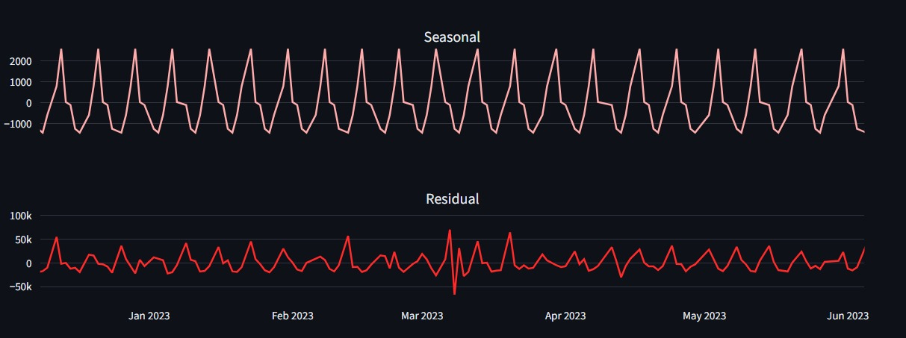
SEASONALITY
There is clear seasonality in the product quantities
We know that there is a system with cyclical behaviour driven by predictable factors
Dry Product Quantities

Slide 11
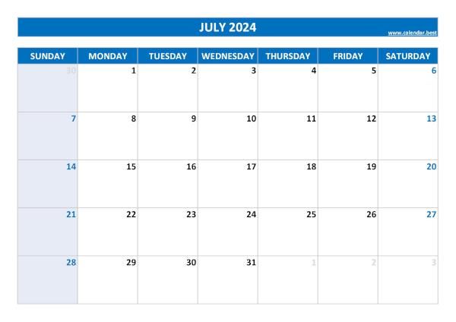

SEASONALITY
Each week the peak moves to the next day of the following week.
For example:
Week 1 peak on Tuesday
Week 2 peak on Wednesday
Week 3 peak on Thursday
…

Slide 12
Observed Pattern
The observed patterns on the other hand showed peaks every Monday…
That part came from the Residual part of the time series
Our model had to carefully account for both

Slide 13
RECURSIVE FORECASTING EVERY WEEK FOR 3 WEEKS
RECURSIVE FORECAST
Available Data
18-08 - Sunday
1 week forecast
(week of interest)
02-01-2023
17-08-2024
19-08
05-09
11-09
Actual values
1-week forecasts
1-week forecasts
New Actuals
New Actuals
Our case: Forecast horizon of 1 week with a lead time of 2 weeks
Daily Forecasts for a period of 1 week

Slide 14
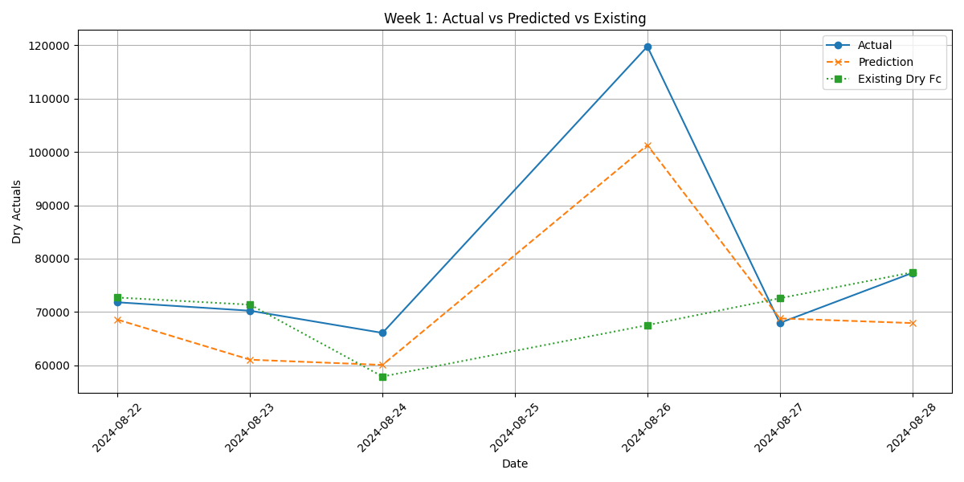
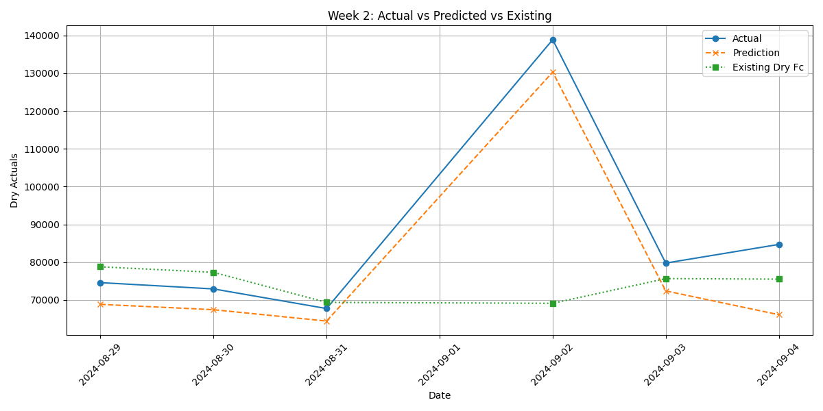
RECURSIVE FORECASTING EVERY WEEK FOR 3 WEEKS
RECURSIVE FORECAST
August 2024 – September 2024
22-08
28-08
29-08
04-09
Example: Dry Category
1st-week forecasts
2nd-week forecasts
New Actuals
Our case: Forecast horizon of 1 week with a lead time of 2 weeks

Slide 15
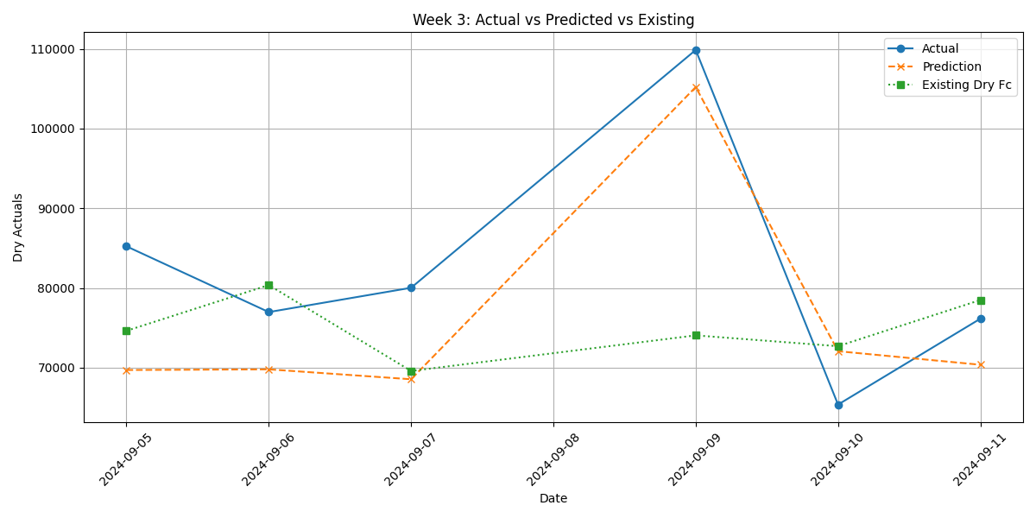
RECURSIVE FORECASTING EVERY WEEK FOR 3 WEEKS
RECURSIVE FORECAST
August 2024 – September 2024
22-08
28-08
29-08
04-09
11-09
Example: Dry Category
1st-week forecasts
2nd-week forecasts
3rd-week forecasts

Slide 16
RECURSIVE FORECASTING EVERY WEEK FOR 3 WEEKS
RECURSIVE FORECAST
Example: Dry Category
August 2024 – September 2024
22-08
28-08
29-08
04-09
11-09
Feature | SHAP Value
ema_same_day_4weeks | 5155.453
Dry Actuals_lag_6*Day_Monday | 3225.7097
Frozen_lag_21*Day_Monday | 2604.259
Dry Actuals_lag_6 | 2145.1506
Fresh_lag_7*Day_Monday | 1888.8235
1st-week forecasts
2nd-week forecasts
3rd-week forecasts
Monday Interactions: Big effect due to pronounced weekly patterns and peaks every Monday.

Slide 17
FINAL METRICS COMPARISON
PERFORMANCE ACROSS ALL 3 WEEKS
Final Metric Comparisons between Our model and the company’s current model
 | OUR MODEL |  | EXISTING MODEL
Category | Error | Accuracy | Error | Accuracy | Improvement
Dry | 9.83% | 90.17% | 12.38% | 87.62% | +2.55%
Frozen | 17.17% | 82.83% | 21.12% | 78.88% | +3.95%
Ultra-fresh | 23.38% | 76.62% | 26.08% | 73.92% | +2.70%
Fresh | 6.42% | 93.58% | 5.06% | 94.94% | -1.36%

Slide 18
SOFTWARE & DASHBOARD

Slide 19
BUSINESS IMPACT

Slide 20
Business Impact
Our results deliver tangible value to the company!
Warehouse Management and Logistics
Supplier Relationship
Customer Satisfaction
Reduced stockouts and overstocking
Optimize staffing and logistics costs
Enable faster turn around times.
Accurate predictions enhance better communication with suppliers
Enhanced reliability as suppliers are less likely to face last-minute orders or cancellations.
An efficient supply chain ensures timely product availability and customer satisfaction

Slide 21


Reflection
Recommendations
Lessons learned
Integrate the predictive model into procurement planning
Data quality issues were a significant hurdle; resolving them improved model accuracy
Real world data can bear significant challenges.
Working within large teams can mean dealing with serious communication and collaboration issues
Conduct quarterly reviews to retain the model as trends evolve

Slide 22
Future Opportunities
Keep optimizing the model.
Extension of the model to other supply chain departments or product categories.
Deployment of the model and integration into our dashboarding app for live predictions
Integration of external data
Notes:
Photo by Markus Spiske on Unsplash

Slide 23
Eleftherios Kokkinis
Rachael Natumanya
THANK YOU
Notes:
Photo by Markus Spiske on Unsplash

